Slide 1

Employee performance analysis using excel
PRESENTED BY : NARUSU CHAITANYA KUMARI
REGISTER NO. : 322200059
NM ID : 21FBBCF94B34817BF34477FCEC2B6C8F
DEPARTMENT : COMMERCE ( HONOURS )
COLLEGE NAME : SRI KANYAKA PARAMESWARI ARTS AND SCIENCE COLLEGE FOR WOMEN

Slide 2
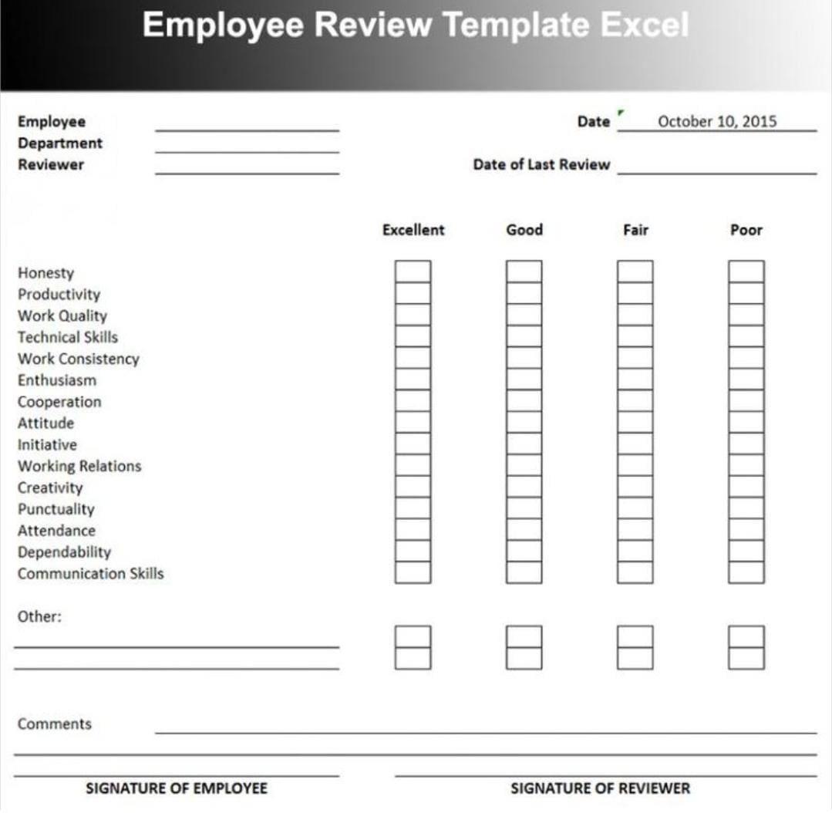
PROJECT TITLE
EMPLOYEE PERFORMANCE ANALYSIS USING EXCEL
Reduce and Eliminate Expenses
Decide on a Location
Set Goals and Create a Plan

Slide 3
AGENDA
1 . Problem Statement
2 . Project Overview
3 . End Users
4 . Our Solution and Proposition
5 . Dataset Description
6 . Modelling Approach
7 . Results and Discussion
8 . Conclusion

Slide 4
PROBLEM STATEMENT
The problem is to identify the Human Resources (HR) department of XYZ Corporation aims to evaluate and improve employee performance across various departments. Currently, performance data is collected, but it is not systematically analysed to provide actionable insights. The HR team needs a comprehensive analysis of employee performance metrics to identify top performers, underperformers, and trends over time.

Slide 5
PROJECT OVERVIEW
Analyze employee performance metrics to identify strengths, areas for improvement, and overall trends.
Implement PivotTables to summarize and categorize performance data.
Compare individual employee performance against benchmarks or targets.
Analyze seasonal or project-specific performance variations.
Design dashboards for easy visualization of performance metrics.
Share analysis results with management for decision-making.

Slide 6
WHO ARE THE END USERS ?
Human Resources Team
Managers
Executives
Training and Development Teams
Compensation and Benefits Team
Performance Review Committees

Slide 7
OUR SOLUTION AND ITS VALUES PROPOSITION
Flexibility to adapt the analysis to different roles, departments, or performance criteria, ensuring relevance and accuracy in evaluations.
Solution Data-driven analysis that support performance reviews, promotions, compensation decisions, and targeted training.
Solutions The ability to analyze both current and historical performance data, with periodic updates to keep information.
Value Proposition Saves time and reduces the risk of human error, ensuring consistent and reliable reporting across the organization.
Value Proposition Ensures the tool evolves with the organization's needs, staying relevant and effective in a dynamic work environment.

Slide 8
DATASET DESCRIPTION
EMPLOYEE ID: Unique identifier for each employee in the organization.
FIRST NAME: The first name of the employee.
PAY ZONE: The pay zone or salary band to which the employee's compensation falls.
DEPARTMENT TYPE: The broader category or type of department the employee's work is associated with.
CURRENT EMPLOYEE RATING: The current rating or evaluation of the employee's overall performance

Slide 9
MODELLING
DATA SET: Kaggle, Employee dataset
FEATURE SELECTION: Slicer, Conditional Formatting, Designing
DATA CLEANING Missing values, Irrelevant data, Correct Errors, Remove Unnecessary Columns and Rows
PIVOT TABLE: Employee ID, First Name, Performance Score.
CHART: Report of Employee Performance based on their Current Ratings is resented as Column Chart

Slide 10
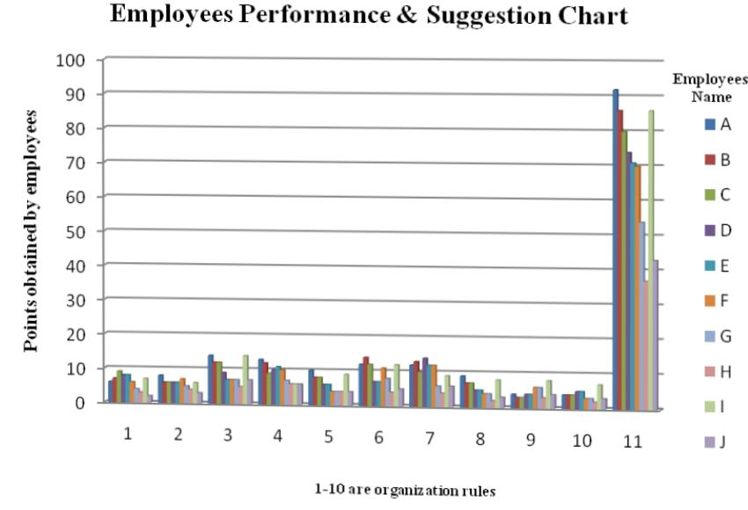
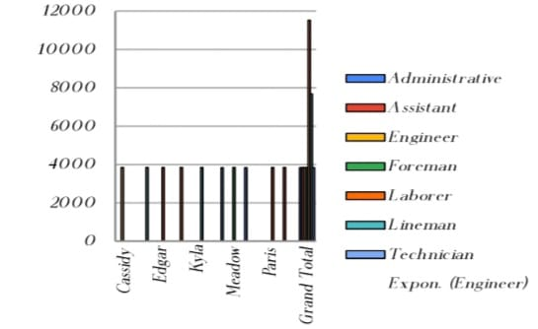
RESULTS

Slide 11
CONCLUSION
In conclusion, conducting an employee performance analysis using Excel provides a structured and efficient way to evaluate and track performance metrics. Excel's versatile functions and tools, such as pivot tables, charts, and conditional formatting, allow for clear data visualization and analysis, facilitating informed decision-making. By systematically analyzing performance data, management can identify trends, strengths, and areas for improvement, enabling targeted interventions and fostering a culture of continuous improvement. Regular updates and reviews of this data ensure that performance management remains dynamic and aligned with organizational goals.

Slide 12

Thank you

